Slide 1
Ellipse Fitting
COMP 4900C
Winter 2008

Slide 2
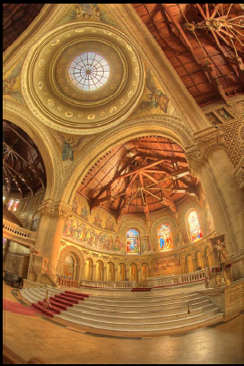
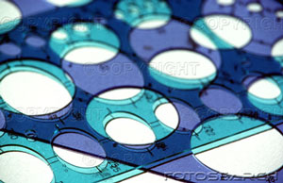
Ellipses in Images
Perspective projection of circles form ellipses in the images.

Slide 3
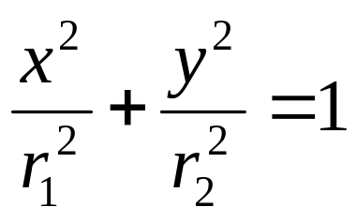
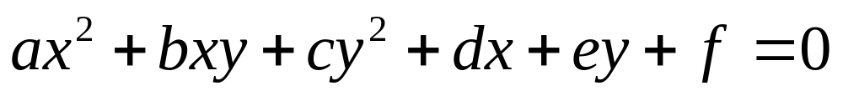
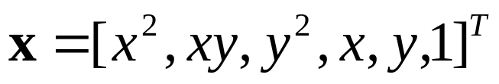
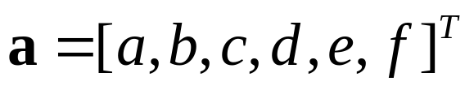
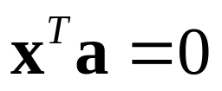
Equations of Ellipse
Let
Then

Slide 4




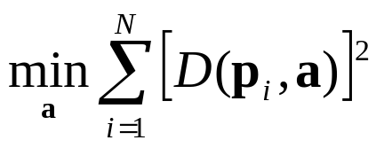


Ellipse Fitting: Problem Statement
Given a set of N image points
find the parameter vector such that the ellipse
fits best in the least square sense:
Where is the distance from to the ellipse.

Slide 5



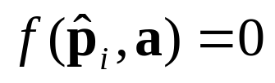

Euclidean Distance Fit
is the point on the ellipse that
is nearest to
is normal to the ellipse at

Slide 6
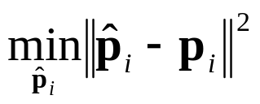
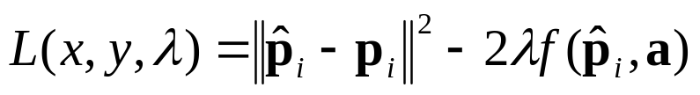

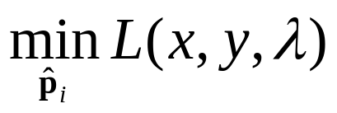
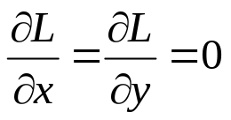

Compute Distance Function
Computing the distance function is a constrained optimization
problem:
subject to
Using Lagrange multiplier, define:
where
Then the problem becomes:
Set
we have

Slide 7

Two Approximations
1. First-order approximation at
2. Assume is close to , then

Slide 8

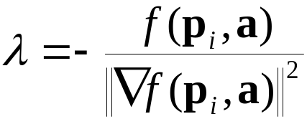
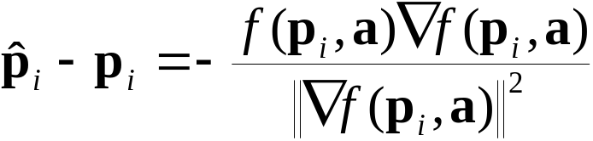
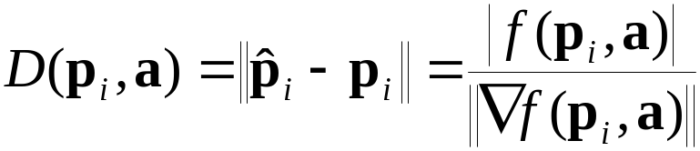
Approximate Distance Function
Solve for
Substitute back

Slide 9
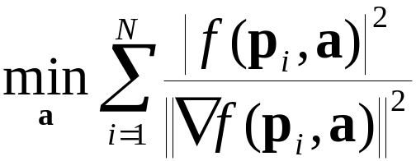
Ellipse Fitting with Euclidean Distance
Given a set of N image points
find the parameter vector such that
This problem can be solved by using a numerical nonlinear
optimization system.

